Slide 1
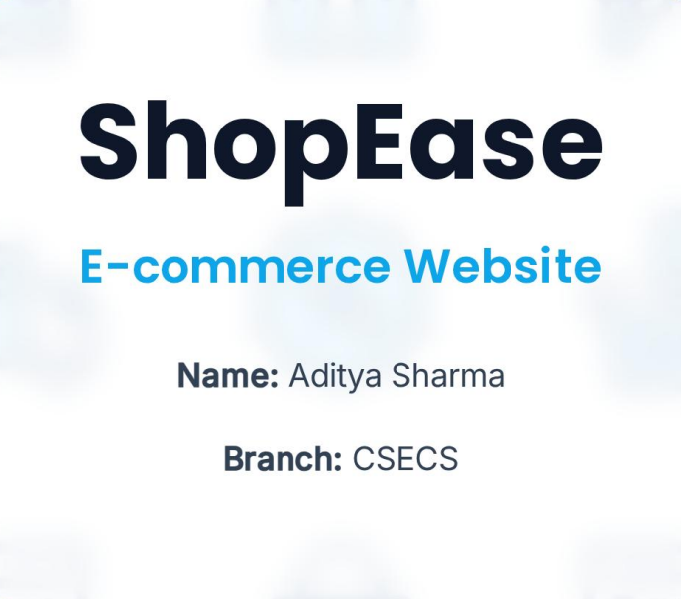

Slide 2
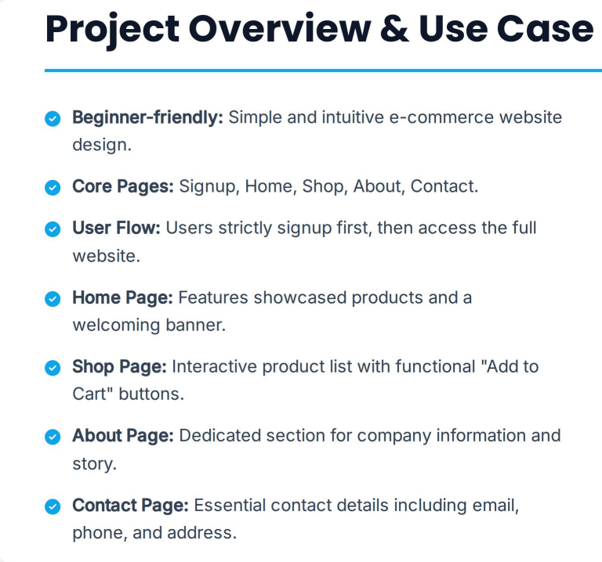

Slide 3


Slide 4
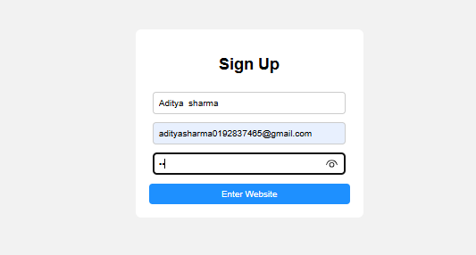

Slide 5
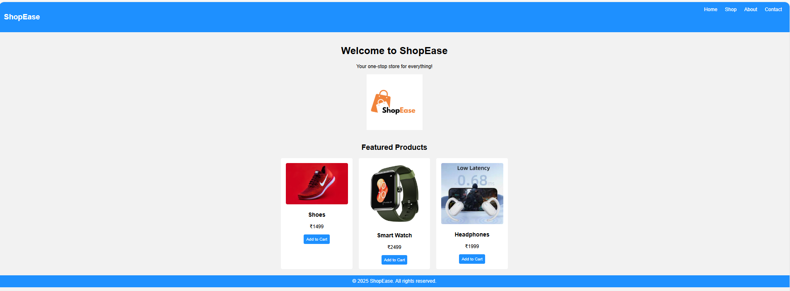

Slide 6
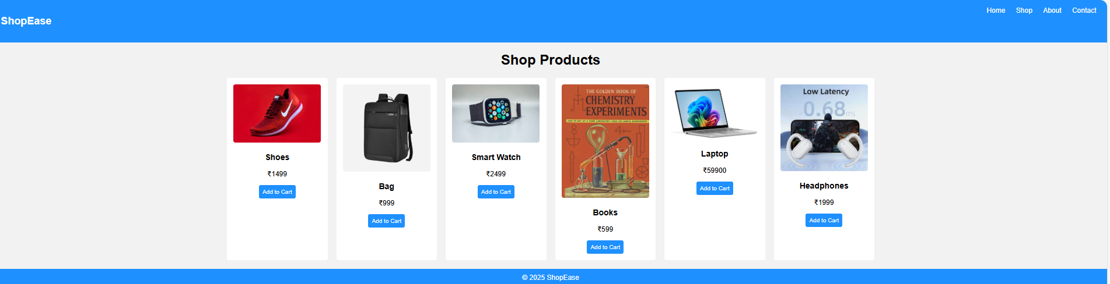

Slide 7
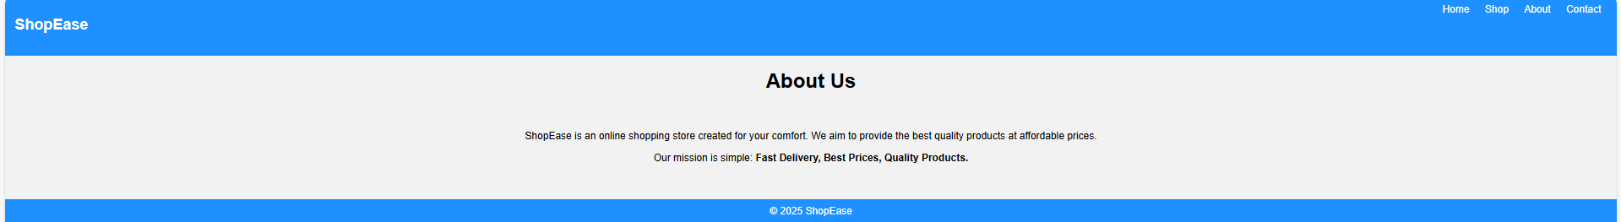

Slide 8
Navigation Bar
<div class="navbar">
<h2>ShopEase</h2>
<div class="links">
<a href="index.html">Home</a>
<a href="shop.html">Shop</a>
<a href="about.html">About</a>
<a href="contact.html">Contact</a>
</div>
</div>

Slide 9
Sign-Up Form Submit
function Form() {
let name = document.getElementById("name").value;
let email = document.getElementById("email").value;
let pass = document.getElementById("pass").value;
if (name === "") {
alert("Please enter your name");
return false;
}
if (email === "") {
alert("Please enter your email");
return false;
}
if (pass === "") {
alert("Please enter your password");
return false;
}
alert("Signup Successful!");
return true;
}
Function addToCart()
{
alert(“Item added to Cart”);
}

Slide 10


